Slide 1
Intervention Plan for CCPA Theatre Conservatory: Professional Development
ORGD 460: INTERVENTIONS AND APPLICATIONS
Emily McConnell
Notes:
My name is Emily McConnell and this presentation is the final project for the course ORGD 460: Interventions and Applications.
This presentation will lay out an intervention plan for the Theatre Conservatory of the Chicago College of Performing Arts (or CCPA)

Slide 2

Introduction
This presentation is the intervention plan for issues uncovered during an organizational culture assessment of the Chicago College of Performing Arts Theatre Conservatory.
The assessment process included in-person interviews with 5 colleagues, as well as evaluation of the three levels of culture analysis laid out by Edgar Schein: artifacts, espoused beliefs, and underlying assumptions.

Slide 3
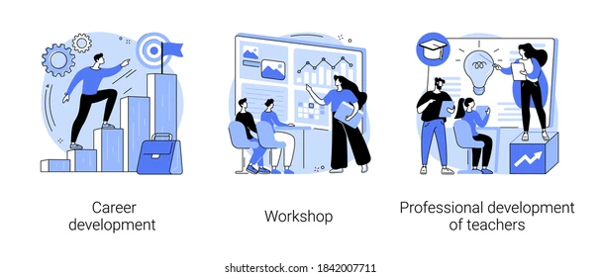
Current Conditions
Interviews with faculty and staff in the CCPA Theatre Conservatory revealed confusion and omissions in the professional development process. This includes the evaluation and review process, training for new positions or promotion, and mentorship opportunities.
Notes:
For a separate course in Organization Culture, I conducted interviews with several staff and faculty members in January and February of 2024. A consistent issue that was raised in these interviews was disappointment and confusion around the professional development process. Staff and faculty saw gaps in the evaluation and review process, limited training for new positions or promotion, and few mentorship opportunities.

Slide 4
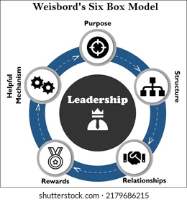
Diagnostic Process
Organizational Culture Assessment:
  Interviews with 5 organization members
  Based on the Weisbord Six-Box Model
Notes:
The interviews I conducted were with 5 members of the organization, including faculty and staff members, and ranging in experience from 6 months to more than 15 years. The interviews and assessment were based on Marvin Weisbord’s Six-Box Model.

Slide 5
Diagnostic Process
Organizational Culture Assessment:
  Interviews with 5 organization members
  Based on the Weisbord Six-Box Model
  Professional Development revealed as an issue in the topics of Rewards and Relationships
Notes:
The two categories in the Six-Box model that include questions related to Professional Development are Rewards and Relationships

Slide 6
Interview Excerpts
1 out of 5 employees recalls a direct review with a supervisor, more than 3 years ago
Faculty members describe a lack of formal mentorship; newest faculty member says “there’s whispers of that”
Staff members describe the annual self-review system as “a joke”
3 out of 5 employees had received some type of promotion during their tenure, but limited training or preparation; “…you get some degree of information about that title, but you hadn’t necessarily gotten anything prior to that.”
Notes:
Here you can see some specific excerpts and details from these interviews (count to 10)

Slide 7
Importance of Professional Development in Higher Education
“….academics working in a strong, collegial department [are] more likely to develop strategic and successful research careers. By contrast, academics working in less collegial departments viewed their probation as bureaucratic and unsupportive” (Hollywood et al, 2020).
“As institutions struggle with new COVID-based realities, an organizational emphasis on ‘people’ and relationships should be part of, if not central to our faculty development conversations. Whether formal or informal, mentorship can help establish and sustain a faculty community” (Carpenter et al, 2022).
Notes:
Several researchers have written on the importance of professional development systems in higher education. (Count to 5). The CCPA faculty and staff both described seeing mentorship and development opportunities in other departmental areas and expressing a desire for that type of community building and support.

Slide 8
Intervention Structure:
Employee Engagement Process
Survey and Results
  Transparency of Process
    Action Planning Sessions
      Goal-Driven Work Groups
        Employee-Driven Change
(Holman, Devane, Cady, 2006, p. 507-512)
Notes:
The intervention I have laid out in this presentation is modeled on the Employee Engagement Process. This process relies initially on survey methodology, but emphasizes transparency in the process and involving employees as well as management in the action planning and goal setting in order to make successful changes.

Slide 9

Intervention Process: Preparation
Conversation with leadership: how do supervisors and managers currently handle professional development?
Document review: what official processes are documented in employee handbooks?
Survey: Based on initial interview information, survey wider sample on current experience and satisfaction level
Notes:
Additional preparation would be needed for this intervention, including conversations with leadership and management to understand their view of the situation, a review of official documentation and university standards for professional development, and a full survey of faculty and staff based on the McCormick Employee Engagement Inventory.

Slide 10

Intervention Process: Opening
The Fishbowl:
Notes:
The Opening workshop in this plan would use the Fishbowl exercise.

Slide 11
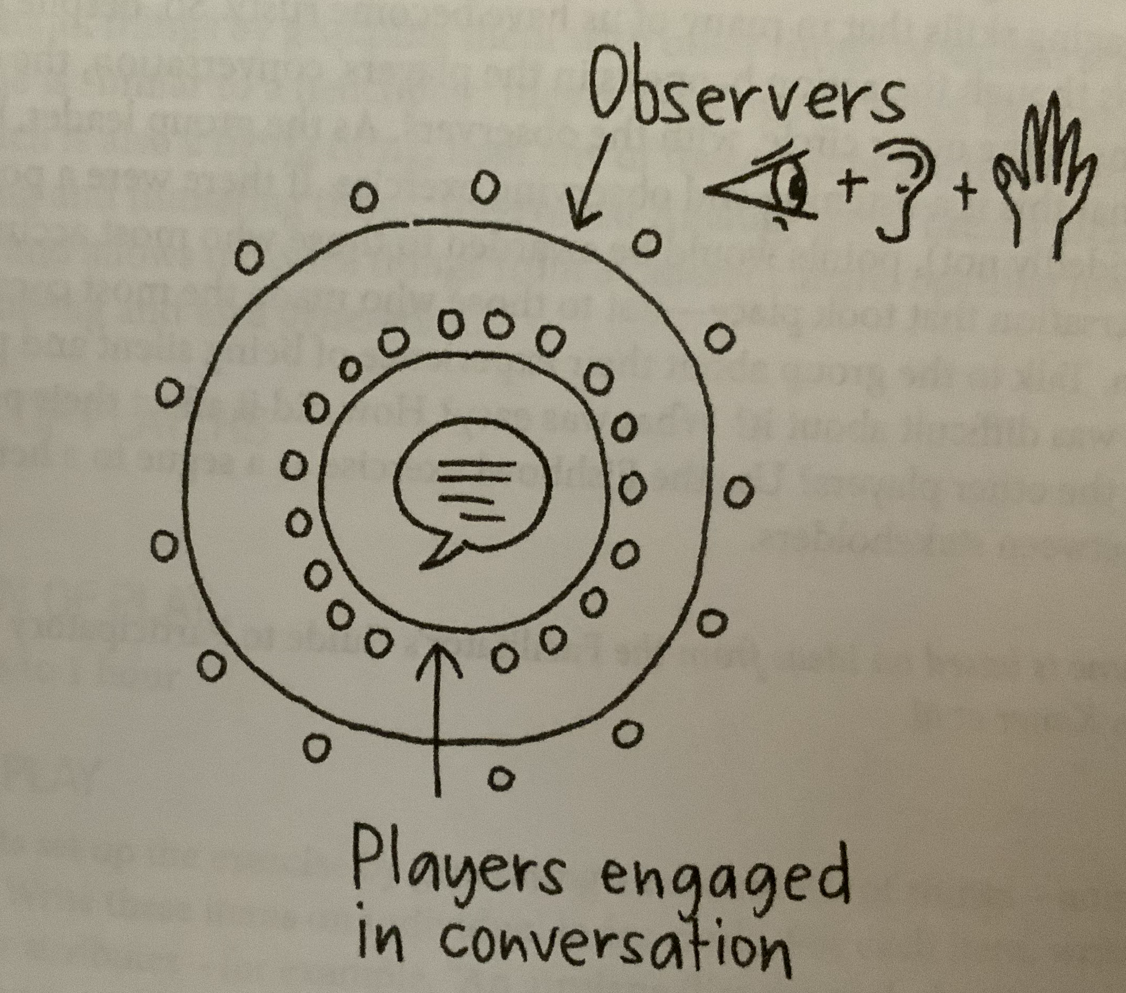
Intervention Process: Opening
The Fishbowl:
  Participants are arranged in 2 circles
  Outer circle (observers) have a handout on which to take notes but cannot speak
  Inner circle (players) take up questions related to professional development
(Gray, Brown, Macanufo, 2010, p.92)
Notes:
This activity would use questions developed through the survey results around the topic of professional development at CCPA, and have management and employees take up both Observer and Player roles in exploring these questions. Observations and discoveries would be shared at the end of the workshop with the facilitators using those results to shape the next steps in the intervention.

Slide 12

Intervention Process: Exploring
Activity: Heart, Hand, Mind
“Significant products, activities, and experiences appeal to a whole person; they ‘feed the heart, hand, and mind.”
Use survey feedback and discoveries from Fish Bowl exercise to generate specific action plans – for each, identify with the group ways in which that plan is:
  Emotionally engaging (heart)
  Tangible and practical (hand)
  Logical and reasonable (mind)
(Gray, Brown, Macanufo, 2010, p.179-180)
Notes:
The Exploring portion of the intervention would involve generating specific action plans (using the results from the Opening workshop), and then as a group, processing those plans through the Heart, Hand and Mind framework described on this slide. Facilitators would use the results of this workshop to refine the action plans.

Slide 13

Intervention Process: Closing
Activity: Start, Stop, Continue
  What processes have been working for us?
  What processes are no longer working and can be stopped?
  What new processes need to be implemented?
  (Gray, Brown, Macanufo, 2010, p.249)
Notes:
The Closing process for this intervention plan would involve looking back over the full workshop process and identifying as a group what processes should Start, Stop or Continue. The goal from this final workshop would be to have action plans with specific targets, assigned people in charge of action items, and realistic timelines.

Slide 14
Intervention Process: Evaluation
Should mirror preparation steps:
  Follow-up with leadership – how are new processes working? How do they view the professional development process now?
  Documentation - have new processes been officially entered into employee handbooks and organizational files?
  Surveys – how do results compare to initial surveys?
    Intervention exit surveys
    1 month post-intervention to keep action plans on track
    6 months post-intervention
    1 year post-intervention
Notes:
The evaluation for this intervention should be similar to the preparation steps as outlined here: checking in with leadership and management; updating official documentation to reflect the recommended changes; and a series of surveys to compare to the pre-intervention survey results.

Slide 15

Implementation Timeline: 5 Months
Preparation: 3 months
Opening Session: 1 day workshop; 2 weeks to compile notes and results
Exploring Session: 1 workshop session on generating action plans; 1 workshop session on assessing plans through “Heart, Hand, Mind”; 2 weeks to compile notes and results
Closing Session: 1 day workshop
Action plan evaluation 1 month post-intervention
Notes:
I propose a 5 month timeline for this intervention: 3 months for the preparation and survey work; 1 month for the workshops themselves, and a 1 month evaluation for the action plans. (In the previous slide I also recommend future evaluations at 6 months and 1 year post-intervention, as these will best indicate the sustainability of any changes).

Slide 16
References
Carpenter, R., Dvorak, K., Strawser, M. G., Gonzalez, V., & Aming, D. (2022). Situating Faculty Mentorship and Mentor Models. The Journal of Faculty Development, 36(1), 33–37
Gray, D., Brown, S., & Macanufo, J. (2010). Gamestorming. O’Reilly Verlag.
Hollywood, A., McCarthy, D., Spencely, C., & Winstone, N. (2020). ‘Overwhelmed at first’: the experience of career development in early career academics. Journal of Further and Higher Education, 44(7), 998–1012. https://doi.org/10.1080/0309877X.2019.1636213
Holman, P., Cady, S., & Devane, T. (2006). The change handbook. Berrett-Koehler.
Weisbord, M. R. (1976). Organizational Diagnosis: Six Places To Look for Trouble with or Without a Theory. Group Organization Management. DOI: 10.1177/105960117600100405
Notes:
This slide lists the books and articles referenced in this presentation. Thank you for your time.
Feedback from Dr Orr:
Emily!
I love your work here! First of all, it's great that you took information and work you developed in ORGD 400 and applied it in a real and appropriate way to this course. (It demonstrates that you see the connections between the content and how it all links together!)
I would caution on the use of fishbowl a little bit - but artistic folks tend to be more risk-takers - some people might be reluctant to be in the inner circle is my caution. Noting observations identified by the inner circle may make some people feel "called out". At the same time, no intervention is a risk free proces.
Your connection to evaluation as well is really strong here. And by the way, I think that this problem is not just in CCPA -- it is institution wide. And the self-evaluation and TK20 software - I don't know if staff use that or not -- is AWFUL. LOL

