Slide 1


Diversity and Inclusion Plan for Thousand Waves Martial Arts &
Self-Defense Center, NFP
Final Project – ORGD 485: Leveraging Diversity
By Emily McConnell
Notes:
This is my final project presentation for the class ORGD 485, Leveraging Diversity, with Professor Pamela Randle. My name is Emily McConnell, and I am a student in the Masters of Arts in Organization Development at Roosevelt University.
For this project, I have put together a hypothetical diversity and inclusion plan for the organization Thousand Waves Martial Arts & Self-Defense Center, NFP.

Slide 2
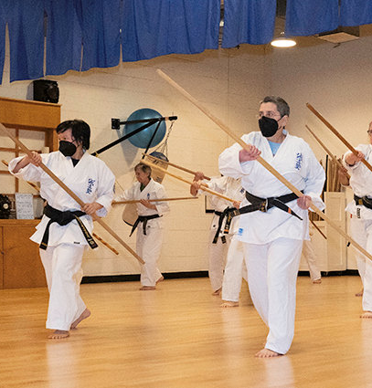
Background
Thousand Waves Martial Arts & Self-Defense Center, NFP is an organization located in the Lakeview neighborhood of Chicago, IL.
From their website:
Thousand Waves Martial Arts & Self-Defense Center, NFP fosters fitness, healing, empowerment and peacemaking by promoting healthy minds and bodies through violence prevention, self-defense and traditional martial arts programs for adults and children of all ages.
Our members apply the skills they learn at Thousand Waves to transform their lives at home, school, work, and in public spaces. This creates a powerful community spirit of civility, self-worth, and compassion in action.
Through partnerships with schools, other non-profits, businesses and government agencies, we also bring the tools of violence prevention and personal empowerment to diverse communities. We encourage everyone’s participation regardless of racial or ethnic background, religion, age, sexual orientation, gender identity, or fitness level.
The organization’s mission statement and espoused values
Notes:
A little background on this organization: Thousand Waves is part of the World Seido Karate global network of dojos, teaching Seido karate, a form which was created in 1972 by Tadashi Nakamura. I have listed their mission on this slide, as outlined on their website.
The primary missions of Thousand Waves are fitness, healing, empowerment and peacemaking; these are primarily pursued through karate training for children and adults as well as self-defense training courses.

Slide 3
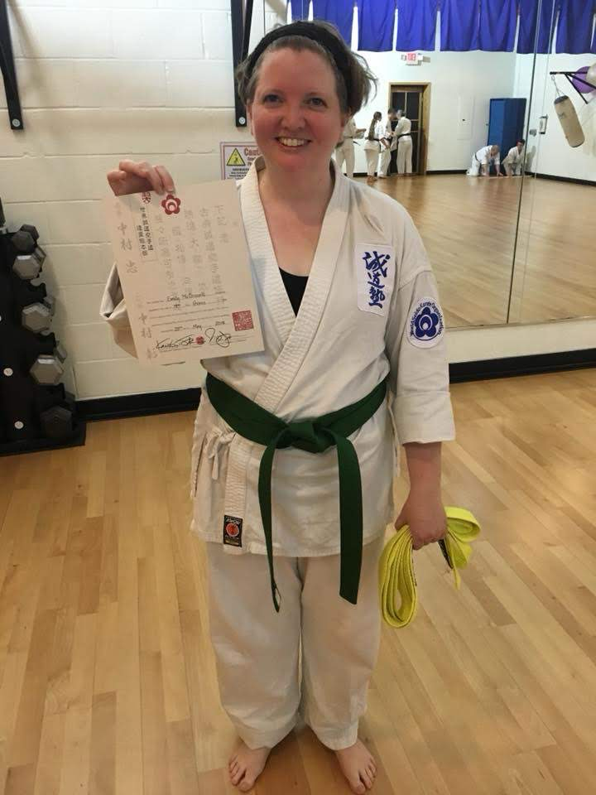
Personal Connection
I have been a training member of Thousand Waves since 2015.
I will be testing for my black belt in Seido Karate on October 26, 2024
Notes:
My familiarity with this organization comes through training there as a member since 2015. I have also taken some of their self-defense workshops.

Slide 4

Organization Details
Publicly available information on the organization’s history and finances
Notes:
Let’s look at the publicly available information on Thousand Waves’ history and finances before we dive into a more specific plan.

Slide 5
Thousand Waves Martial Arts & Self Defense Center, NFP
History
Finances
Founded as “The Women’s Gym” by Nancy Lanoue and her partner Jeannette Pappas in 1984.
  Originally structured as a feminist health club that offered training in Seido karate.
  By 1991, school had 50 women and 20 child students.
In 1995, school changed its name to Thousand Waves, moved to current location on Belmont Ave, and began offering classes to all genders.
In 2001, organization incorporated as a 501(c)(3) not-for-profit organization, with a board of directors.
In 2016, founders stepped down to focus on teaching, and TW hired Ryan Libel as first non-founding Executive Director.
As of 2016, Thousand Waves had 225 members of all ages and genders.
Thousand Waves 2022 tax filings show:
  $416K in revenue
  $450K in expenses
  $420K in assets
  $23.7k in liabilities
2022 income sources were primarily program services, supplemented by fundraising, contributions, and a small amount of inventory sales
As of 2022, TW only has one permanent paid employee, its Executive Director
Sources:
https://thousandwaves.org/about-us/
https://projects.propublica.org/nonprofits/organizations/364471839
Notes:
As you can see here, Thousand Waves was first founded as an organization for women and children only. After operating for 11 years, they opened up classes to all genders. From my own observations as a member now, the gender demographics are quite diverse, but there are still more women than other genders. The teacher population is very evenly split across genders.
We do not have publicly available data on the current member numbers – anecdotally, I know that the membership dropped significantly during the Covid shutdown of 2020-2021 when training had to move either outside or online, but those numbers have been going up steadily the last 2-3 years.
The most recent published 990 forms are from 2022, which show more expenses than revenue – this reflects the impacts of that Covid drop in membership, once government subsidies were not as available to small businesses. As of 2022, Thousand Waves had 1 paid employee – I believe there are now 2 permanent employees, the Executive Director, and the Director of the Youth Program.

Slide 6

Making a Plan
Laying the groundwork for a successful diversity and inclusion plan
Notes:
Thousand Waves prides itself on being a member-led organization. The following Phases lay out steps for centering the full membership in creating and implementing a diversity plan.

Slide 7
Phase 1: Preparation
Assessment
Leadership
Build an assessment of the current state of the organization
  What are the demographics of current membership?
  Who makes up the board?
  Who are the current volunteer and paid staff?
What are the strengths of the organization now around diversity and inclusion?
  e.g. a long history of gender inclusion
What are the challenges for the organization now around diversity and inclusion?
What qualities of the organization support change?
What qualities of the organization are barriers to change?
Engage executive director, board, and senior leadership council in conversations and education around diversity initiatives and organizational change
Share information gathered from assessment
Define equitable outcomes:
  What does diversity and inclusion mean specifically for Thousand Waves?
  Who are the communities TW aspires to serve?
Establish a timeline for achieving goals
Identify primary leaders for diversity initiatives
Notes:
Steps are taken from the book “Equity: How to Design Organizations where Everyone Thrives” by Minal Bopaiah; and the workbook “Step-By-Step: A Guide to Achieving Diversity and Inclusion in the Workplace” by the Diversity and Inclusion Initiative for Third Sector New England.
No diversity and inclusion plan can start without a complete and honest assessment of where the organization stands today. It is important to look at the demographics of membership, staff and board, and to use that information to identify the strengths and challenges for the organization for diversity and inclusion. Part of this assessment should also be looking at organizational culture, in order to identify the drivers of change and the barriers to change.
The first groups that should commit to any diversity and inclusion plan are the leaders in the organization. For Thousand Waves, that would be the executive director, the board of directors, and the council of senior leaders – a committee of training members that assists the executive director with operational decision-making and planning.
The most important piece in this phase is using the assessment information to identify equitable outcomes. A diversity and inclusion plan needs to be specific to this individual organization and the communities that organization serves – so naming those goals in ways that are unique to Thousand Waves will be important to the success of this plan.

Slide 8
Phase 2: Groundwork
Conversations
Transparency
Set up info sessions with stakeholder groups:
  Purpose is to share results of assessment work and the initial definition of goals
  Groups would include: senior leadership council, staff (volunteer and paid), training members, families of child members, self-defense students, partner groups & agencies
  Collect responses, concerns, disagreements, additions – use information to adjust assessments if needed
Hold brainstorming sessions for action steps to achieve common goals:
  Brainstorming groups would combine members of different stakeholder groups in each session
Create section of website where ongoing work can be shared and tracked with all members of organization
  Make meeting times public whenever possible
  Hold some meetings virtually or in hybrid format to ensure full accessibility
Identify other similar organizations, including within the World Seido Karate network, that could be models for diversity work.
Share goals, as well as criteria to measure success of these goals.
  Be honest about both advantages and costs to anticipated changes, in order to get informed buy-in from stakeholders
Notes:
Once leadership has done this preparatory work, it should be shared in an open and transparent way with everyone that makes up the Thousand Waves community. This sharing process could (and really should) inspire leadership to revisit some of those initial definitions and goals to make sure that they reflect the ideals of their stakeholder groups.
I have laid out some steps here for establishing that transparency. One important step that I feel is often missed is being honest about both the benefits that come with making your organization more diverse and inclusive, as well as the costs (which could be financial, logistical, or emotional). You can create buy-in for planned changes within your community even with costs – but if people only find out about the costs later, their feelings about the whole process will be tainted.
Leading with conversations and full transparency is a complicated process, but will pay off in the end by helping to make lasting changes in the organization.

Slide 9
Phase 3: Implementation
Design
Evaluation
Recommend hiring external consultant for these steps if not already engaged
Use brainstorming session results to build action steps. Different action steps should address:
  Organizational demographics
  Externally focused messaging (member recruitment, program advertising)
  Internally focused systems (member communications, dojo events)
  Policies and procedures for staff
  Policies and procedures for leadership and board
For each action step, establish the leader responsible, timeline, and criteria for evaluation.
Set up guidelines for addressing challenging reactions in a timely manner.
Seek ongoing feedback from participants – use it to refine ongoing activities and monitor progress
  Share feedback regularly with consultants and leadership so changes can be made efficiently
Use both internal and external consultants to implement activities, so organization can receive both objective and informed assessments
Schedule meetings with stakeholder groups at appropriate points along the implementation process to review how members are experiencing process and progress towards goals
Notes:
Design and implementation steps partly inspired by Steep Theatre’s Anti-Racist Action Plan.
The final phase for this plan, Implementation, will involve designing specific interventions as well as evaluating the success of those actions.
I do recommend in this step hiring external consultants to design and guide the implementation of the action steps decided upon. You will need internal consultants as well – leaders from the different stakeholder groups – that can bring the perspective of understanding the lived culture of the organization.
The most important thing about designing any interventions or actions is that they be concrete steps that can be evaluated for success. The organization should continue the transparency initiatives outlined in Phase 1, so that all stakeholders can see those steps and when they are scheduled for completion.

Slide 10

Timeline: to be finalized during Phase 1
Phase 1: Preparation – Month 1
Phase 2: Groundwork – Months 2-3
Phase 3: Implementation – Months 4-6

Slide 11
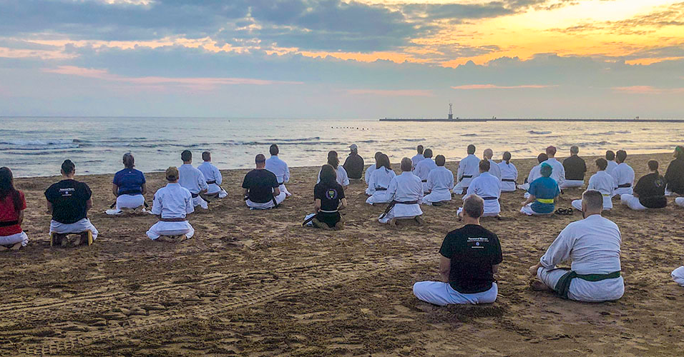
title
Emily McConnell
ORGD 785 – Leveraging Diversity
Emcconnell@roosevelt.edu
October 2024
Beach Training, August 2019
Notes:
Thank you for listening to my presentation, I look forward to your feedback.

